Slide 1
Psalms of Praise
Psalm 103 & Acts 16:16-40

Slide 2
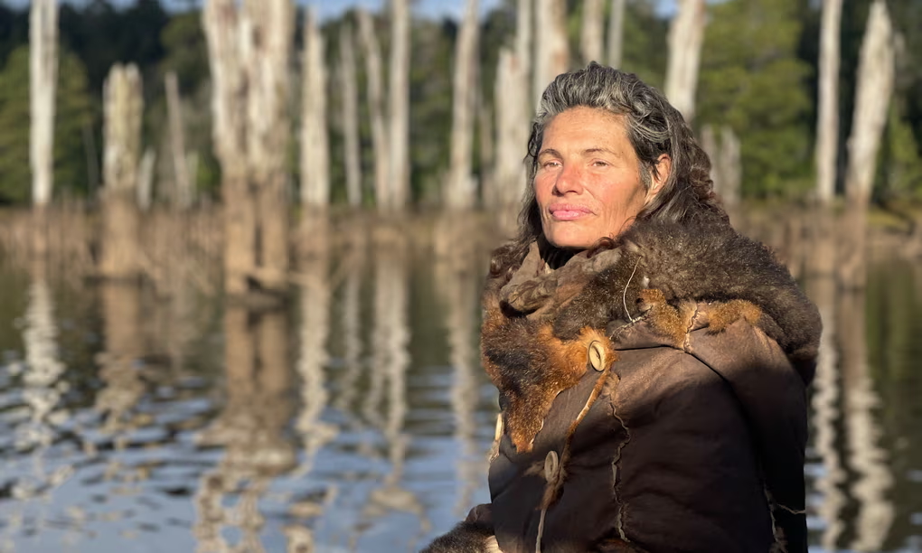
“We very rarely put ourselves into discomfort: we’re pleasure-seeking, pain-avoiding, meaning-making machines. To deliberately lean into the sharp places, that is the best training. Not just for Alone, but for a life of resilience and the ability to connect with the wilderness, inside and out.”
Gina Chick
SBS
“Alone Australia”

Slide 3
Can I learn to adopt a posture of curiosity about how God may be at work in me and in my circumstances?
Can I lean into His sufficiency and authority over my situation?
Practicing praise can help us learn this!

Slide 4
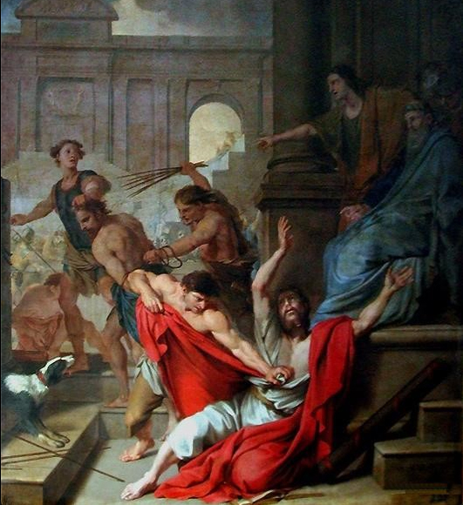
Paul & Silas
Circumstances
Paul and Silas imprisoned for freeing a woman from demon possession
Beaten brutally, in pain
Subject to unjust human authority
Response
Praise to God! “Praying and singing hymns”
Perhaps Psalm 103 ?
Louis Testelin
La Flagellation de Saint-Paul et de Saint-Silas
1655

Slide 5
Praise is an expression of adoration and love for God - His character, purposes and goodness.
God graciously uses praise to transform our hearts and our attitudes as we turn our gaze to him in our circumstances.

Slide 6
Psalm 103
1 Praise the Lord, my soul; all my inmost being, praise his holy name.
2 Praise the Lord, my soul, and forget not all his benefits—
3 who forgives all your sins and heals all your diseases,
4 who redeems your life from the pit and crowns you with love and compassion,
5 who satisfies your desires with good things so that your youth is renewed like the eagle’s.

Slide 7
6 The Lord works righteousness
and justice for all the oppressed.

Slide 8
7 He made known his ways to Moses, his deeds to the people of Israel:
8 The Lord is compassionate and gracious, slow to anger, abounding in love.
9 He will not always accuse, nor will he harbor his anger forever;
10 he does not treat us as our sins deserve or repay us according to our iniquities.
11 For as high as the heavens are above the earth, so great is his love for those who fear him;
12 as far as the east is from the west, so far has he removed our transgressions from us.

Slide 9
13 As a father has compassion on his children,
so the Lord has compassion on those who fear him;
14 for he knows how we are formed,
he remembers that we are dust.
15 The life of mortals is like grass,
they flourish like a flower of the field;
16 the wind blows over it and it is gone,
and its place remembers it no more.
17 But from everlasting to everlasting
the Lord’s love is with those who fear him,
and his righteousness with their children’s children—
18 with those who keep his covenant
and remember to obey his precepts.

Slide 10
19 The Lord has established his throne in heaven,
and his kingdom rules over all.

Slide 11
20 Praise the Lord, you his angels,
you mighty ones who do his bidding,
who obey his word.
21 Praise the Lord, all his heavenly hosts,
you his servants who do his will.
22 Praise the Lord, all his works
everywhere in his dominion.
Praise the Lord, my soul.

Slide 12
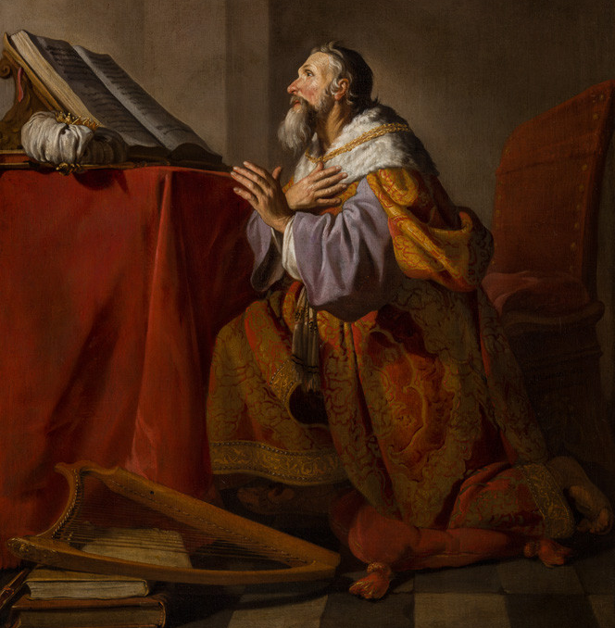
A Psalm of Praise
David compels his soul to “forget not” the benefits of God by:
Desiring closeness to God in spirit
Remembering the character of God
Remembering God’s mission of restoration
Remembering God’s compassion and love for his children
Remembering God’s authority over all
Hendrick Bloemaert
‘Penitent King David’
Oil on canvas
1663

Slide 13
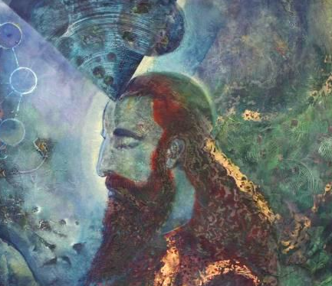
Praise desires closeness to God in spirit.
1 Praise the Lord, my soul; all my inmost being, praise his holy name.
2 Praise the Lord, my soul, and forget not all his benefits—
David finds comfort and solace in the One who knows and loves him most, compelling himself to remember the attributes of this God of love.
Anatoly Schelest
‘King David’
Acrylic On Stretched Canvas
2008

Slide 14
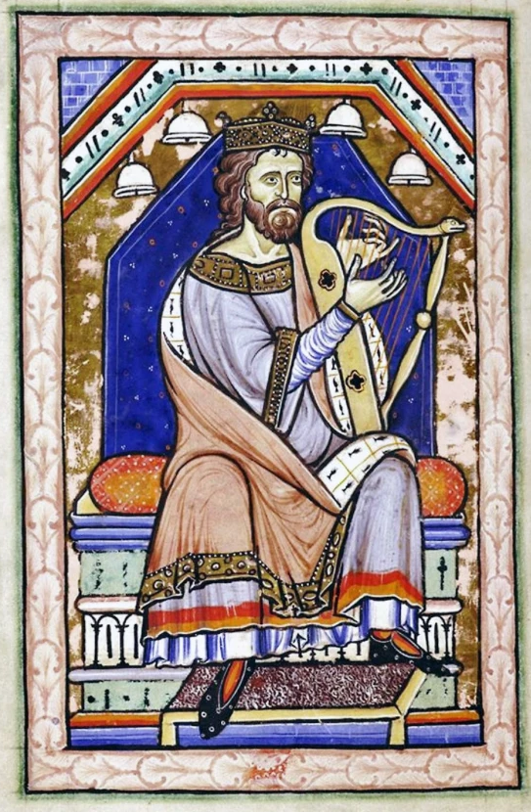
Praise rejoices in the character of God.
2 Praise the Lord, my soul, and forget not all his benefits—
3 who forgives all your sins and heals all your diseases,
4 who redeems your life from the pit and crowns you with love and compassion,
5 who satisfies your desires with good things so that your youth is renewed like the eagle’s.
Unknown Artist
‘David Playing His Harp’’
Westminster Abbey Psalter
C. 1200
David entrusts himself to his good God who renews his spirit.

Slide 15
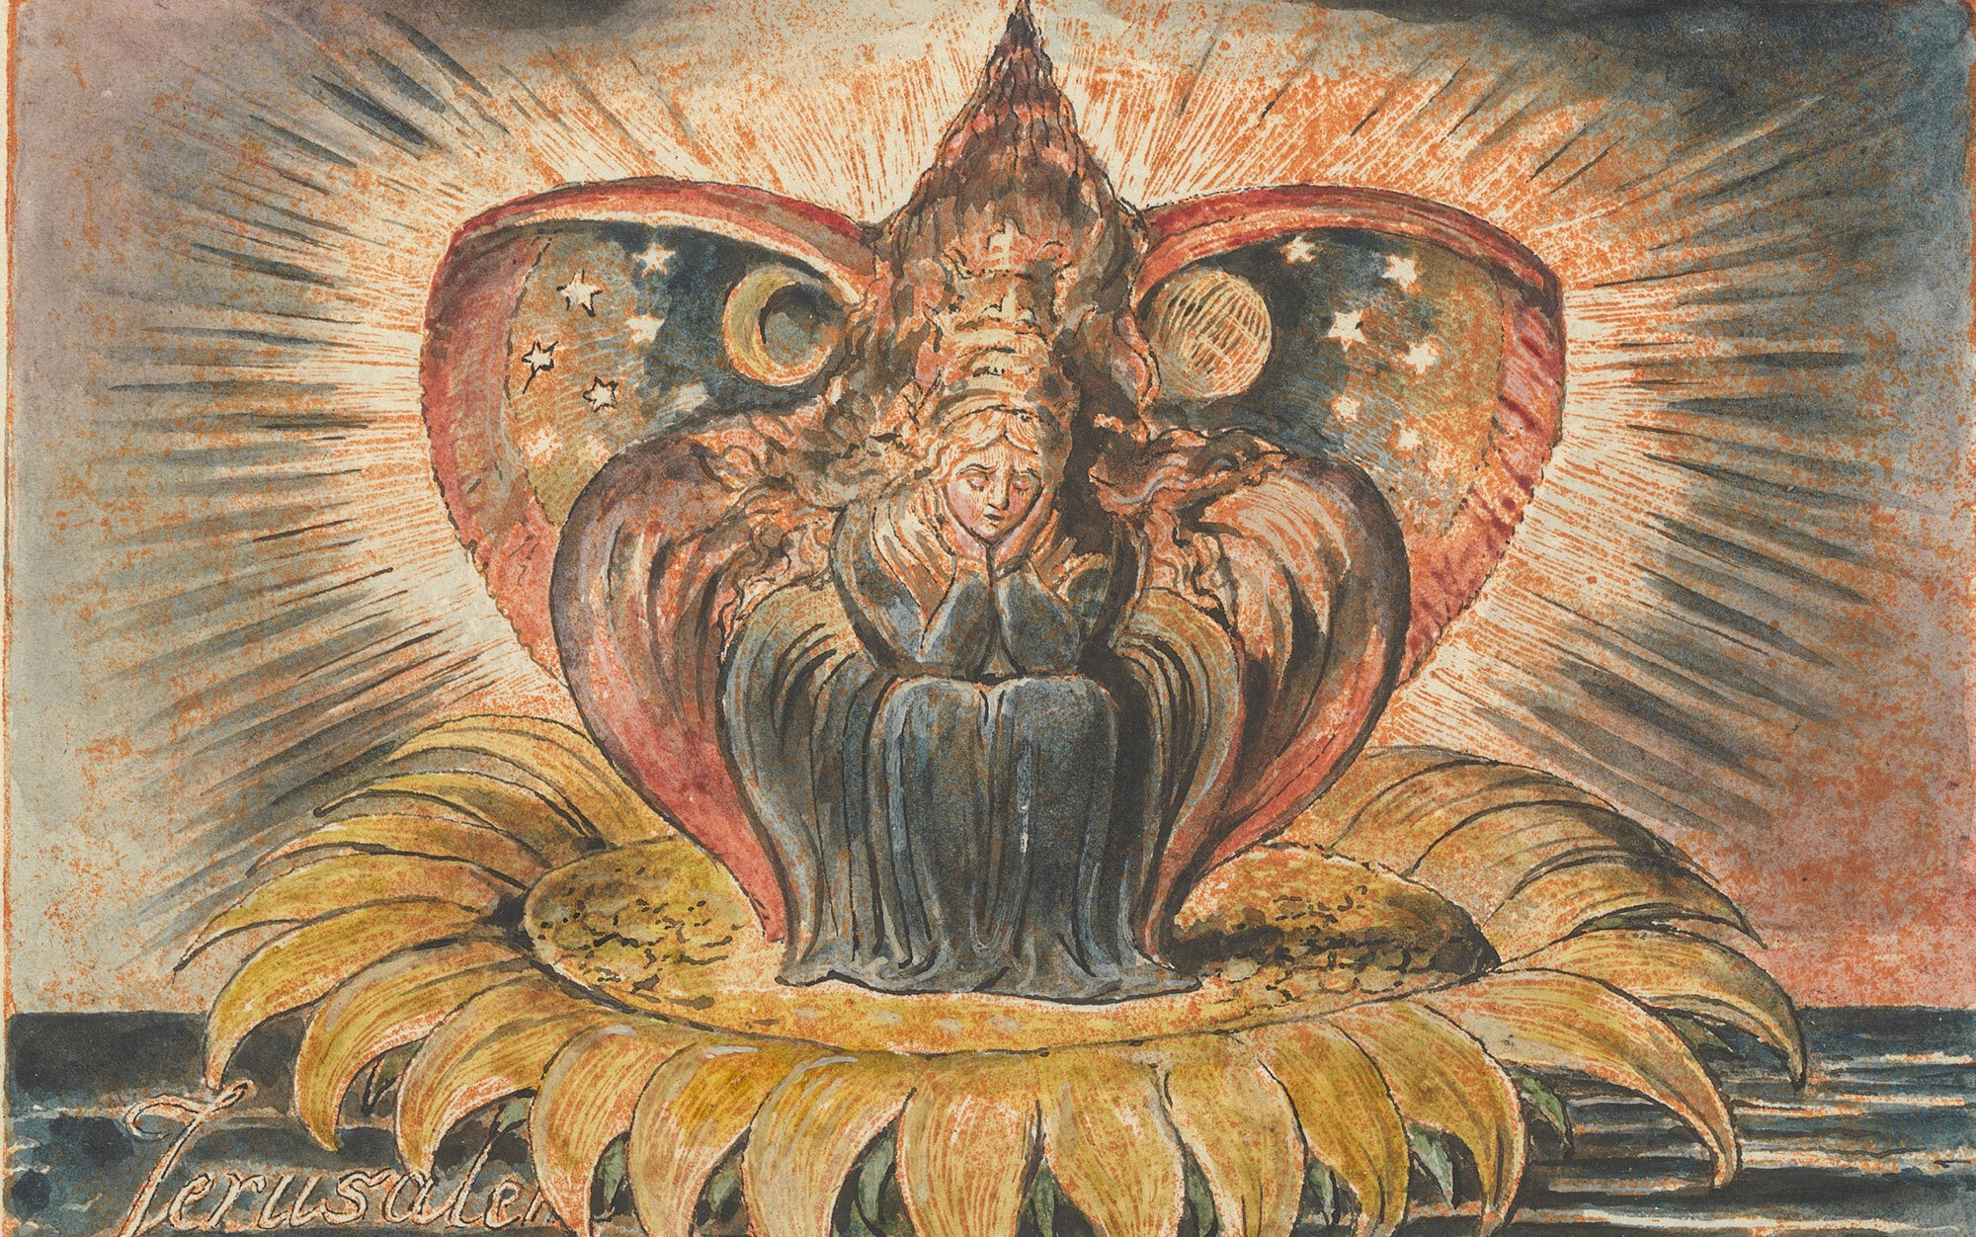
Praise remembers God’s mission of restoration.
6 The Lord works righteousness
and justice for all the oppressed.
Praise speaks the story of restoration over ourselves - reminding us of God’s grand narrative - providing a perspective of hope.
William Blake
From ‘Jerusalem’
Plate 53’
Relief etching
1821

Slide 16
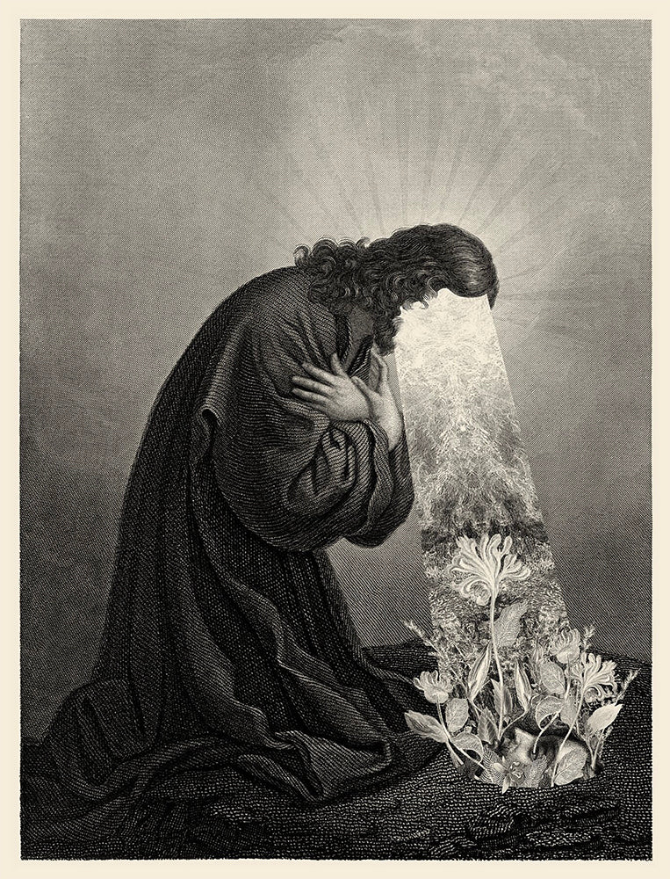
Praise connects us to God’s love and compassion
8 The Lord is compassionate and gracious, slow to anger, abounding in love.
…
13 As a father has compassion on his children,
so the Lord has compassion on those who fear him;
14 for he knows how we are formed,
he remembers that we are dust.
…
17 But from everlasting to everlasting
the Lord’s love is with those who fear him,
God understands us. Our weaknesses are spaces in which God longs for us to lean into his strength.
Dan Hillier
‘Ground’
pigment giclee print
2020

Slide 17
Praise reminds us of God’s authority.
19 The Lord has established his throne in heaven,
and his kingdom rules over all.
Submitting to God’s authority can also bring comfort as we take wise steps to solve problems. The outcome is not completely up to us - God is at work in the hearts of others and in situations beyond what we can imagine. We can act with wisdom, but entrust outcomes to Him.
Scott Erickson
‘Sabbath Rest’

Slide 18
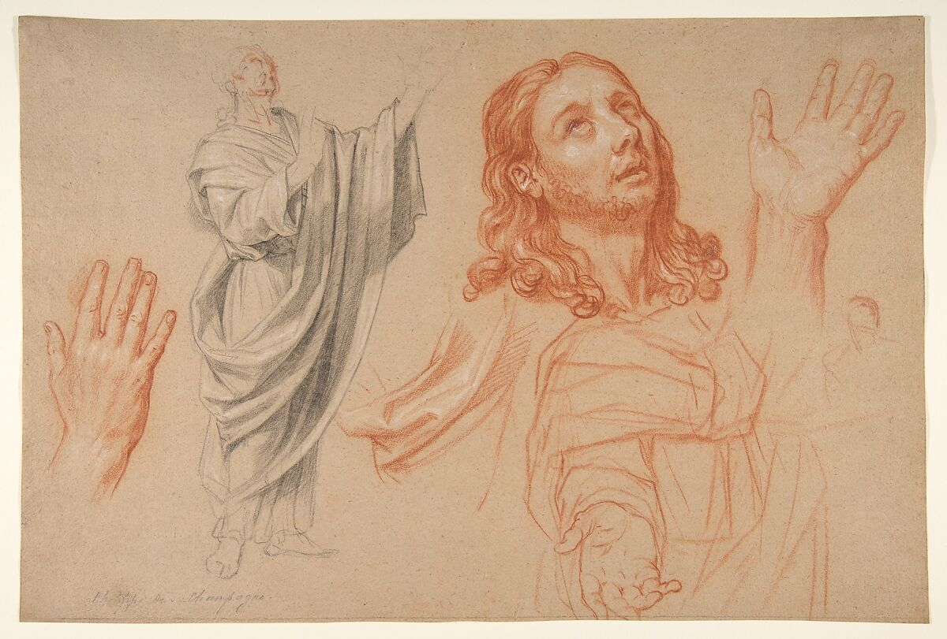
A Posture of Praise
In praise, we do not draw our gaze away from our circumstances, but rather attune our gaze to see God in the midst of our struggles.
God’s purpose in our praise isn’t to free us from our circumstances, but to transform us through them.
Nicolas de Plattemontagne
Studies for 'The Conversion of the Jailer before Saint Paul and Silas'
1666

